Slide 1
Kobizo Test
Planning Report
Vinh Nguyen

Slide 2
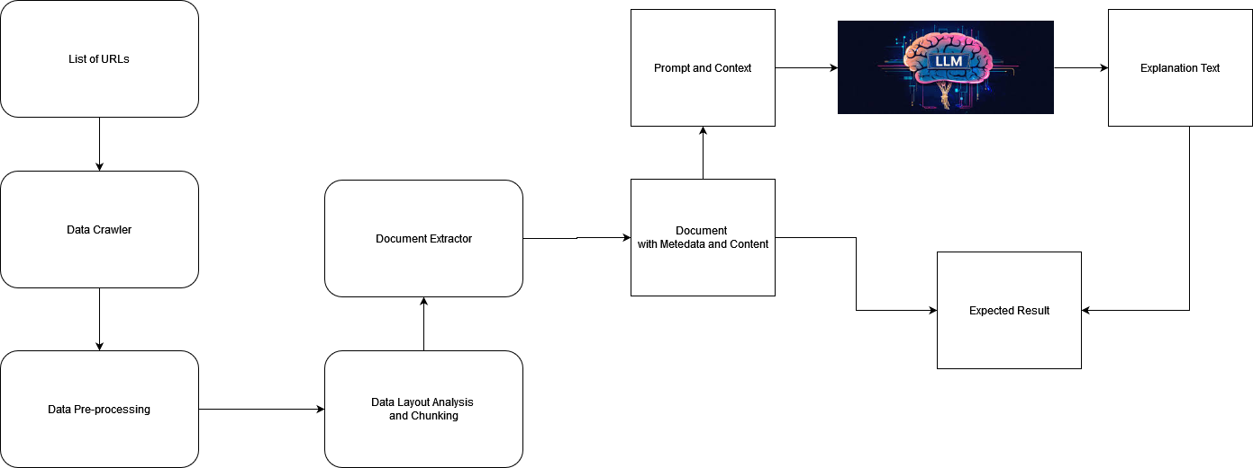
Text content analysis
Problem statement:
Natural language Understanding to detect which paragraph contains any information about the fees or cost or financial obligations which users might incur by using the service or product of a given website
Solution proposals

Slide 3
Text content analysis
Planning
Current status:
Data Crawler: only extract the simple urls, need a better crawling tool for extracting website with high security
No Data Pre-Processing, Data Layout Analysis
Document Chunking/Extractor is simple, need to improve
Explanation Core is simple, need to improve for high accuracy
Proposed plan:
Task | SPOC | Timeline | Expected Result
Data Crawler | Junior | 1 Week | Crawl 90% web Url
Data Pre-processing | Junior | 1 Weeks | Clean/ Good Data
Document Chunking | Junior | 1 Week | Clear Section Segmentation
Document Extractor/ Classification | Senior | 2 Weeks | Detection Accuracy 98% Correct Document Selection 90%
Explanation Module | Senior | 1 Week | full-flow
Testing and deployment | Senior/Junior | 1 Week | Deployment on Cloud if expected

Slide 4
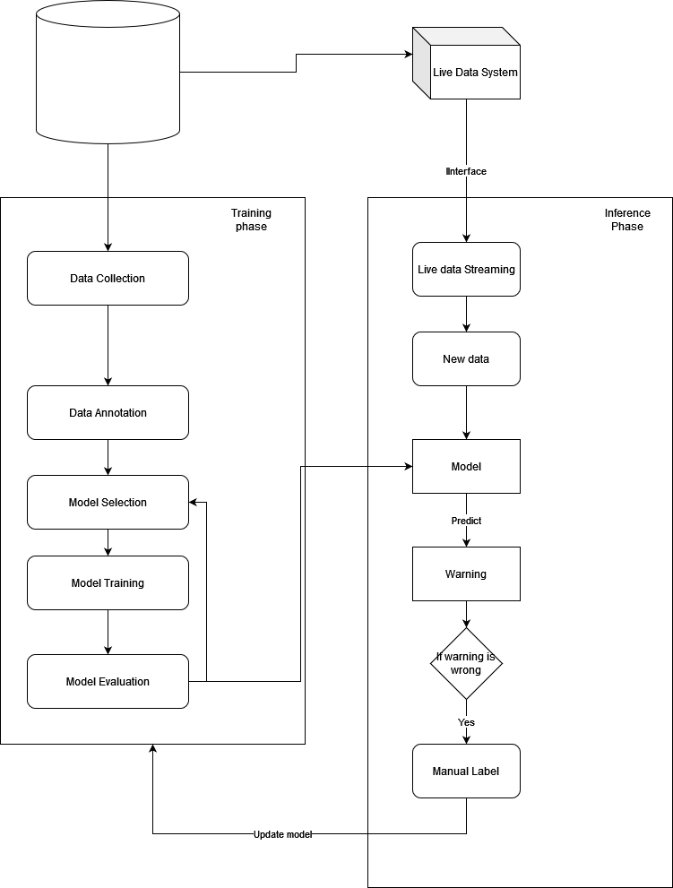
Real-time Analytics and Monitoring
Problem statement:
Anomaly Detection for Fault Transaction
Assumption: dataset with labels (model-based), or no dataset (rule-based)
Solution proposals (see figure)
Done:
Pre-processing data from CSV
Rule-based method to check code base
Training Class with Random Forest (have not tested yet)

Slide 5
Real-time Analytics and Monitoring
Proposed plan:
Task | SPOC | Timeline | Expected Result
Data Crawler | Junior | 1 Week | Crawl 90% web Url
Data Pre-processing | Junior | 1 Weeks | Clean/ Good Data
Document Chunking | Junior | 1 Week | Clear Section Segmentation
Document Extractor/ Classification | Senior | 2 Weeks | Detection Accuracy 98% Correct Document Selection 90%
Explanation Module | Senior | 1 Week | full-flow
Testing and deployment | Senior/Junior | 1 Week | Deployment on Cloud if expected

Slide 6
Smart Contract risk detection
Problem statement:
Code review with security risk warning
Solution proposals
List of repos need to be investigated:
https://github.com/crytic/slither
https://github.com/crytic/not-so-smart-contracts
https://github.com/Messi-Q/AMEVulDetector
LLM Approach:
If dataset with label is available, then can train BERT from scratch, e.g balakhonoff/solidity_security_model_merged
DONE: i have not enough time for code and checking the above approaches.

